Slide 1
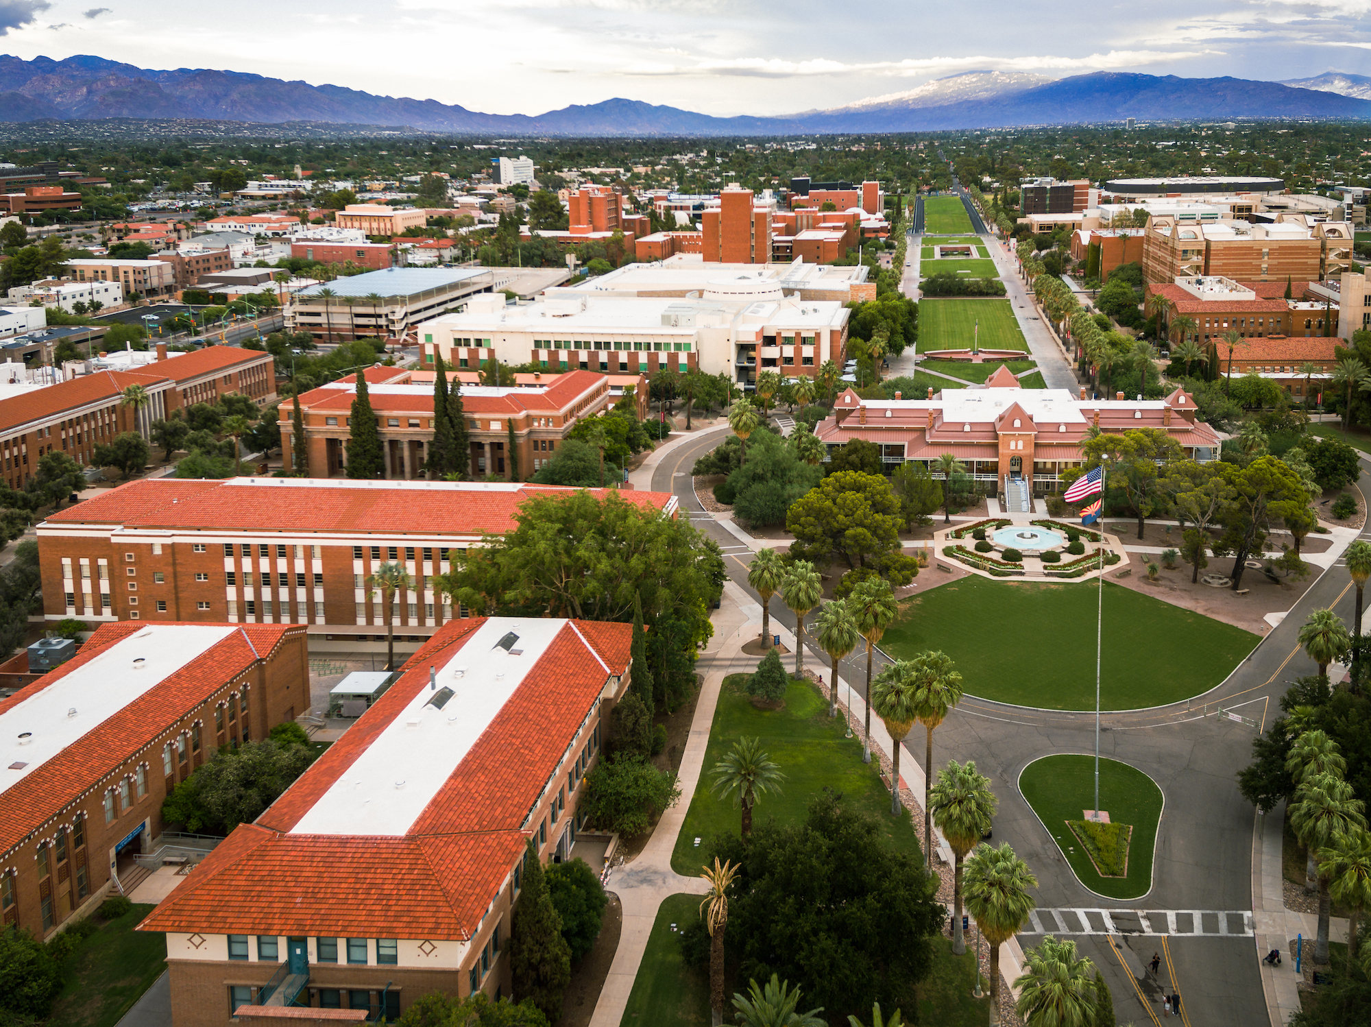



Introduction to Linux on HPC

Slide 2
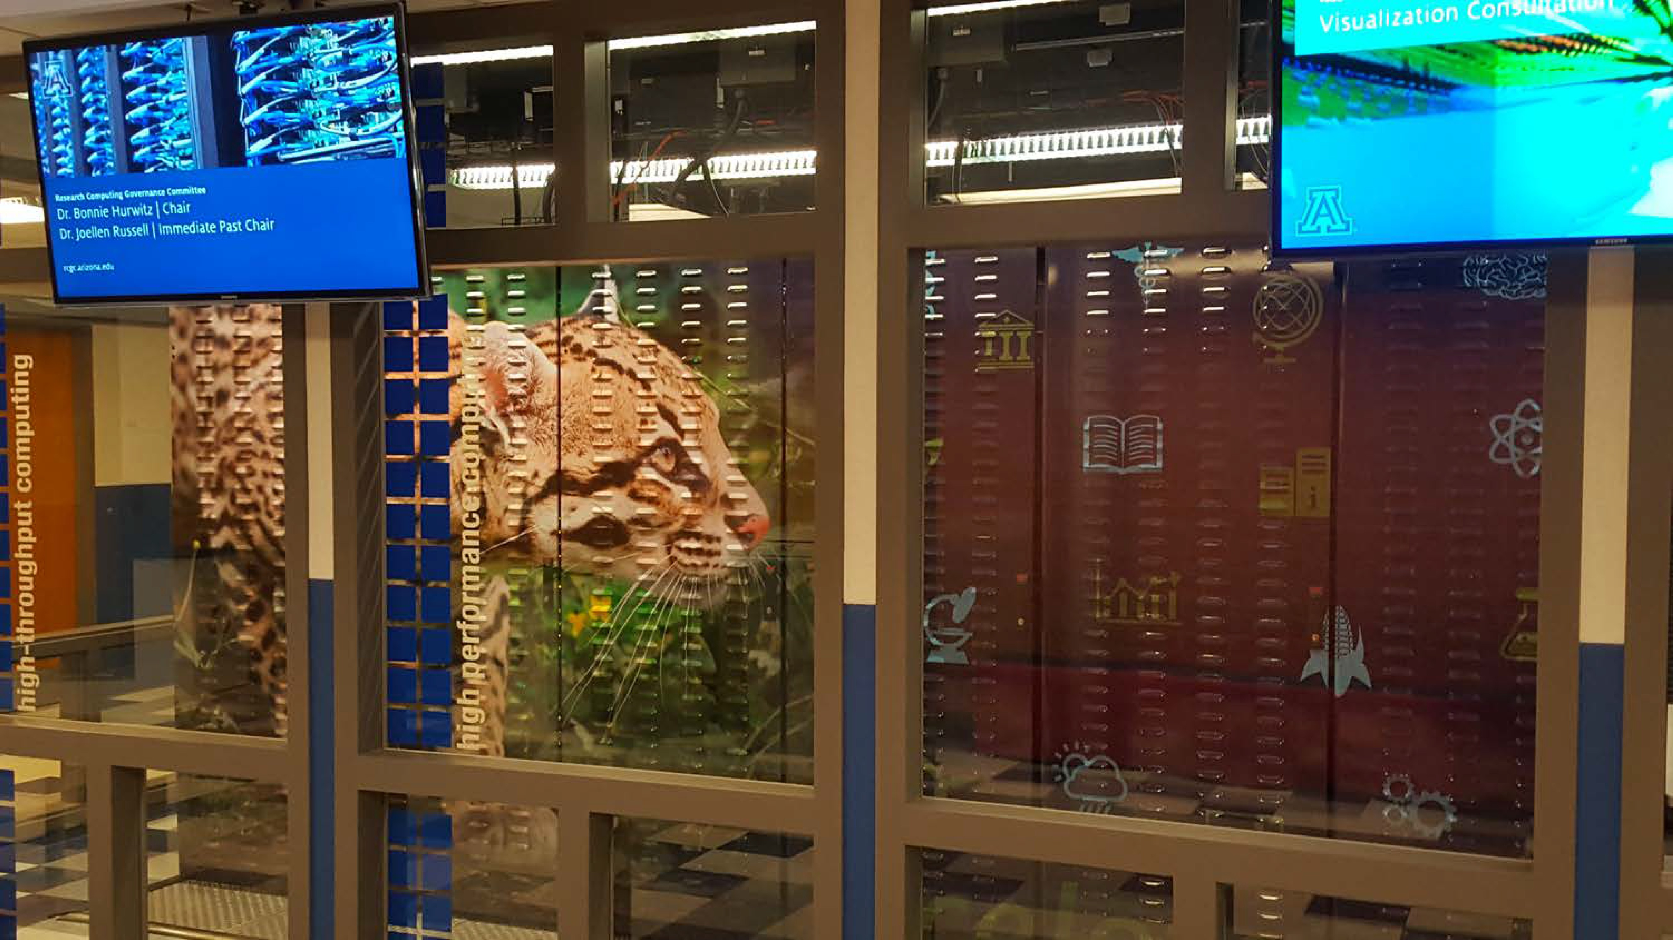
What Is UA HPC?
Provides free services for researchers that include:
Large scale computing
Data storage
Consulting
Training
Our compute clusters are Puma, Ocelote and ElGato
https://ua-researchcomputing-hpc.github.io/Intro-to-HPC/

Slide 3

Puma is a High Performance Cluster
320 compute nodes
30,000 cores
60 Nvidia V100 GPU’s
All-flash filesystem

Slide 4

Opening a Terminal
Mac: Go to Applications → Utilities → Terminal
Windows: Download a terminal emulator - PuTTY: https://www.putty.org - Git BASH: https:gitforwindows.org
Open OnDemand: https://ood.hpc.arizona.edu/

Slide 5
Logging into HPC
Request an Account Sponsored by a PI https://public.confluence.arizona.edu/display/UAHPC/Account+Creation
Access Your Account https://public.confluence.arizona.edu/display/UAHPC/System+Access

Slide 6
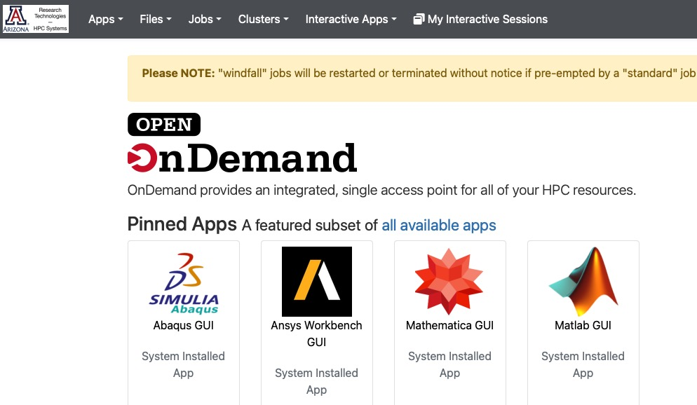
OnDemand GUI Interface
Open ood.hpc.arizona.edu in your web browser and login with your NetID and password.
From the “Clusters” drop-down menu choose which HPC cluster you would like to access:

Slide 7
Command Line Interface
Laptop $ ssh netid@hpc.arizona.edu
This is a bastion host used to access the
rest of the RT/HPC environment.
Type "shell" to access the job submission hosts
for all environments
-----------------------------------------
[netid@gatekeeper ~]$ shell
Last login: Mon Nov 8 20:16:14 2021 from
gatekeeper.hpc.arizona.edu
***
-----------------------------------------
(puma) [netid@junonia 08:35:32 ~]$
bastion
shell
prompt

Slide 8

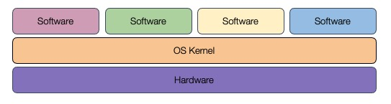
What is Linux?
Part of the Unix-like family of operating systems.
Started in early ‘90s by Linus Torvalds.
Typically refers only to the kernel with software from the GNU project and elsewhere layered on top to form a complete OS. Most is open source.

Slide 9

What is Linux?
Several distributions are available from enterprise-grade, like RHEL or SUSE, to more workstation-focused like Ubuntu.
Runs on everything from embedded systems to supercomputers.

Slide 10
Why use Linux?
Default operating system on virtually all HPC systems and the foundation for many business services globally
Extremely flexible
Fast and powerful
Frequently open source and free
Many tools for software development

Slide 11
Anatomy of a Linux Command
command [flags] [target(s)] ls –l myworkdir
A long list of directory called myworkdir
A directory is a collection of files
Case is important!
Help on commands is available through the “man” command (short for manual) man ls

Slide 12
The Linux Filesystem
System of arranging files on disk
Consists of directories (folders) that can contain files or directories
Levels in file paths separated by forward slashes:
e.g. /home/user/scripts/analyze_data.sh
Case-sensitive; spaces in names discouraged
Some shorthand:
. (the current directory)
.. (the directory one level above)
~ (home directory)
- (previous directory, when used with cd)

Slide 13





























The Linux Filesystem
Multiple Users
/
/bin
/usr
/home
/local
/<username>
Relative path
../../usr/local
/bin
/documents
/hpc
/usr/local/bin
Absolute path
/notes.txt
/home/<username>/documents/hpc/notes.txt

Slide 14
The Filesystems on HPC
/
/home
/groups/PI
/tmp
/xdisk/PI
User with netid kim
[kim@r3u13n1 kim]$ cd /groups/PI
[kim@i5n5 kim]$ cd /xdisk/PI
(puma)[kim@junonia time ~]$ pwd
home/u13/kim
[kim@cpu38 kim]$ cd /tmp

Slide 15









Where Filesystems are Mounted
Bastion host
Nothing here
Login node
/home
/groups/PI
/xdisk/PI
Compute nodes
/home
/groups/PI
/xdisk/PI
/tmp
File transfer node
/rental/PI
Users
Computes nodes
Bastion host
Login node
File transfer node
Shared data storage
Linux jargon: mounted means accessible

Slide 16
Environment Variables
Environment variables are important for Linux users and programs
Type env to see your currently set up environment variables
Useful environment variables:
PATH directories to search for commands
HOME home directory
PWD current working directory
USER username
LD_LIBRARY_PATH directories to search for dynamically-loaded libraries

Slide 17
File and Directory Commands
pwd– prints full path to current directory
cd – changes directory; can use full or relative path as target
mkdir – creates a subdirectory in the current directory
touch – creates an empty file
rm – removes a file (rm -r removes a directory and all of its contents)
cp – copies a file
mv – moves (or renames) a file or directory
ls – lists the contents of a directory (ls -l gives detailed listing)

Slide 18
File Viewing Commands
less– displays a file one screen at a time
cat – prints entire file to the screen
head – prints the first few lines of a file
tail – prints the last few lines (with -f in real-time the end of a file that may be changing)
diff– shows differences between two files
grep – prints lines containing a string or other regular expression ps –ef | grep xx
sort – sorts lines in a file
find – searches for files that meet specified criteria
wc – count words, lines, or characters in a file

Slide 19
Exercise 1: Navigation
Sign-in to your account
Print the path to your current directory
List the contents of this directory
From your home directory create a new directory. How can you be sure the new directory is there?
Change to your new directory and create a file.
Remove the file you just created.

Slide 20
Access the example scripts
How to get there: github.com/ResearchComputing/Supercomputing_Spinup
From home, create a “linux” directory
Change to this directory for the exercises
Git clone the repository:
git clone https://github.com/ResearchComputing/Supercomputing_Spinup.git

Slide 21
Exercise 2: File Viewing
First change to the Supercomputing_Spinup directory Hint: try tab complete
Change to the “linux_bash_spinup/scripts” directory
Print out the entire “test.sh” file
Print out the last 3 lines of “local_vs_global.sh” file
Find how many words are in “case_example.sh”

Slide 22
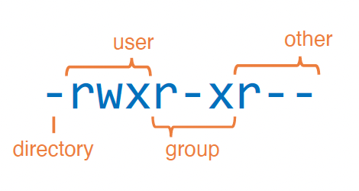
Modes aka Permissions
drwxrwsr-x 2 sarawillis chrisreidy 3072 Nov 8 14:50 system-scripts
-rw-r--r-- 1 baylyd chrisreidy 0 Oct 18 2021 test
3 classes of users:
User (u)
Group (g)
Other (o)
aka “owner”
3 types of permissions:
Read (r)
Write (w)
Execute (x)
Note:
One is a file, the other is a directory
The first name is the owner
The second name is the group

Slide 23
Modes aka Permissions
-rw-r--r-- 1 baylyd chrisreidy 0 Oct 18 2021 test
chmod changes mode
To add write and execute permissions for the group chmod g+wx test or
chmod 674 test
-rw-rwxr-- 1 baylyd chrisreidy 0 Oct 18 2021 test
To remove read permission for all others
chmod o-x test
chmod 670 test
-rw-rwx--- 1 baylyd chrisreidy 0 Oct 18 2021 test

Slide 24
File Types and Dots
drwxr-xr-x. 3 chrisreidy chrisreidy 2048 Feb 10 09:17 bayes
-rw-r--r--. 1 chrisreidy tmerritt 3579 Oct 23 2019 conda-bash.sh
drwxr-xr-x. 3 chrisreidy staff 512 Oct 22 2019 .anaconda
-rwxr-xr-x. 1 chrisreidy staff 121902 Dec 16 2020 nettest
ls short list
ls –l long list
ls –la list hidden files also
cd .. change to parent dir
cd ~ change to home dir

Slide 25
Profiles
-rw-------. 1 chrisreidy staff 2574 Oct 22 2021 .bashrc
Sample Lines
PATH="~/perl5/bin${PATH+:}${PATH}:$HOME/.local/bin"; export PATH;
# Forces ~/.bashrc resource after cluster switch
alias puma=". /usr/local/bin/slurm-selector.sh puma && source ~/.bashrc"
#-# >>> conda initialize >>>
# Python virtualenv
# source ~/tflow/tensorflow_virtual_env/bin/activate
-rw-------. 1 chrisreidy staff 177 Aug 27 2020 .bash_profile
-rw-------. 1 chrisreidy staff 21335 Feb 20 13:26 .bash_history

Slide 26
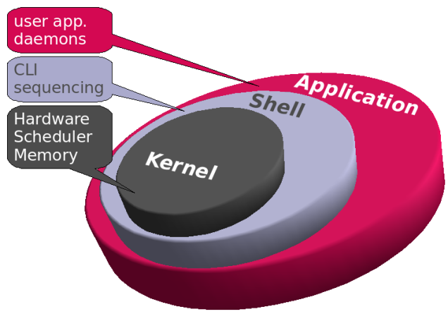
Shells and Shell Scripts
A shell is the environment in which commands are interpreted in Linux.
On HPC we prefer bash (Bourne Again Shell)
Other shells include: sh, csh, tcsh, ksh, zsh
Shell scripts are files containing collections
of commands for Linux systems that can
be executed as programs.

Slide 27
Shells
cont’d
▶ Can be programmed interactively, directly on the terminal.
▶ It can also be programmed by script files. The first line of
the file must contain #!/bin/bash
▶ The program loader recognizes the #! and will interpret the
rest of the line (/bin/bash) as the interpreter program.
▶ If a line starts with #, it is a comment and is not run.
#!/bin/bash # the files in /tmp.
cd /tmp
ls
Shell to run
Comments
Change directories
List everything in /tmp

Slide 28
Exercise 3: Permissions and Running Bash Scripts
Ensure you are in the “scripts” directory
Use less to view the contents of hello_world.txt
Use cat to show the contents of hello.sh in bash_spinup/scripts
Try to run hello.sh by typing ./hello.sh at the command line
Add execute permission to hello.sh using chmod
Try to run hello.sh

Slide 29
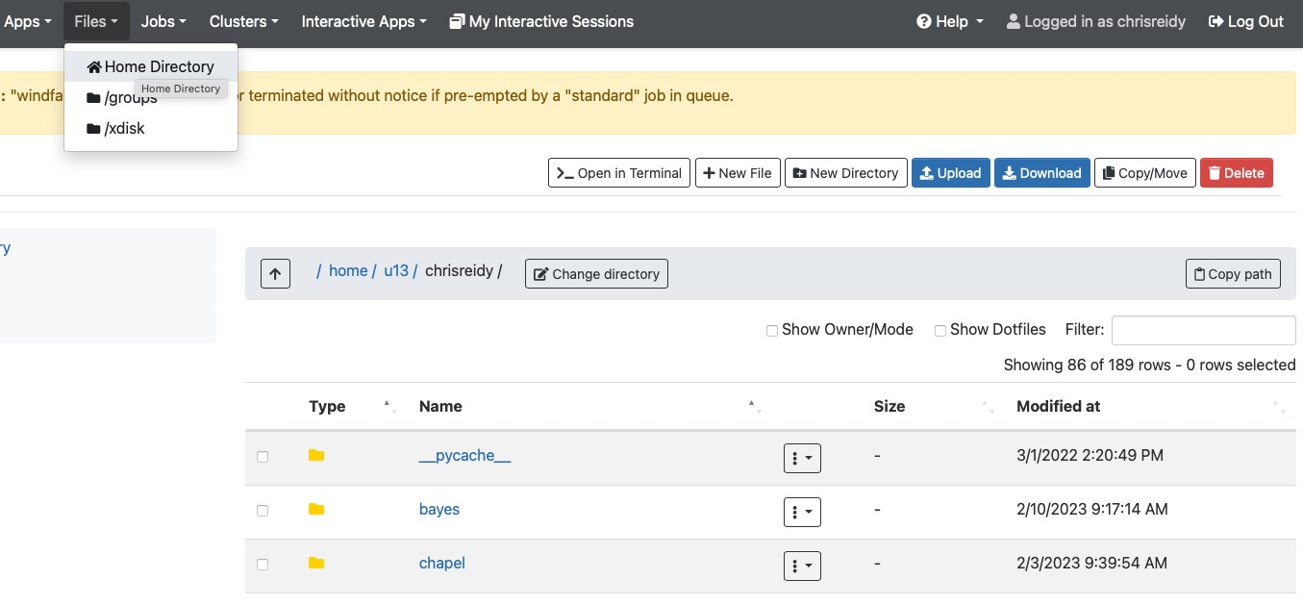
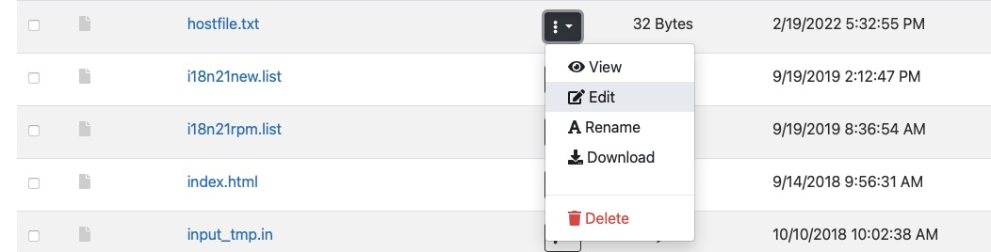
File Editing – the easy way

Slide 30
File Editing – command line
nano – simple and intuitive to get started;
not very feature-rich;
keyboard driven
vi/vim – universal; keyboard-driven;
powerful but has a learning curve
emacs – keyboard or GUI versions;
helpful extensions for programmers;
well-documented
LibreOffice – for WYSIWYG (what you see is what you get)

Slide 31
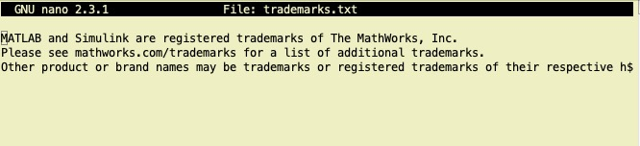
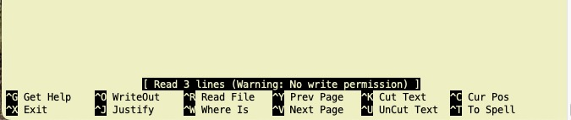
Editing with Nano
$ nano trademarks.txt

Slide 32
Exercise 4: File Editing with Nano
Edit the contents of hello_world.txt contents with nano (you can edit it to say anything!)
Run the program “hello.sh” by typing bash hello.sh or ./hello.sh at the command line

Slide 33
More Resources
Additional Bash learning resources:
http://tldp.org/HOWTO/Bash-Prog-Intro-HOWTO.html (general)
https://www.shell-tips.com/2010/06/14/performing-math-calculation-in-bash/ (math)
Bash kernel for jupyter notebooks (install anaconda first):
https://github.com/takluyver/bash_kernel

